Slide 1
TRAIN DELAY PREDICTOR CSL341: COURSE PROJECT
ABDUL HADI SHAKIR
ANUBHAV SINGH
BHARAT RATAN
RAHUL NAGAR

Slide 2
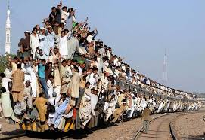
Indian Railways
Lifeline of India
25 million passengers daily
10,000 trains running daily
Running schedule often gets derailed
Lets help out the passengers…

Slide 3
Problem Definition
Deploy Machine Learning to predict the delay in arrival of train(s), using features:
Type of Train
Travelling Distance
Day of Week
Region of Journey

Slide 4
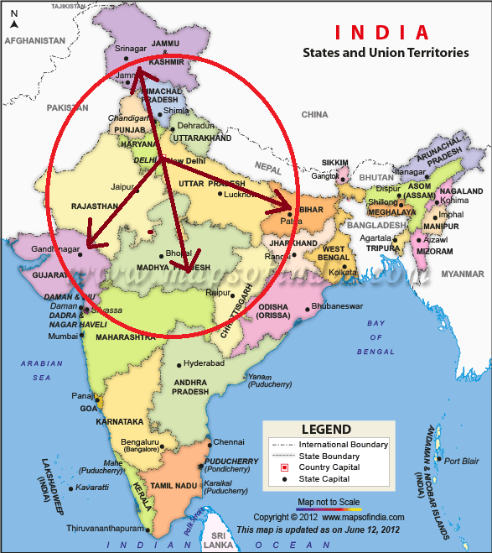
Modeling Indian Railway
Identify major station in IRN in terms of degree of station (connecting stations) and weight of station (traffic).
Delhi/NCR as the origin.
Destination (zones):
Southern UP/Madhya Pradesh Region
Eastern UP/Bihar Region
Rajasthan/Gujarat Region
Chandigarh/Jammu Region

Slide 5
Data Collection
Automated data collection from runningstatus.in
Used python cgi-based scripts
Collected for over a month
80% data points for training
20% data points for testing

Slide 6
Models we looked upon
Support Vector Machine (SVM)
Polynomial Regression
Random Forest

Slide 7
SVM
Used libsvm tool for matlab
Gaussain/RBF kernel with different parameters
Experimented with various SVM models
Binary clasification viz.
Delayed (> 15 mins).
Non-Delayed (0-15 mins)

Slide 8
SVM..
Overfitting of data
Good on train, bad on test
Accuracies
Train : 87.16%
Test : 72.12%
Why?
Variety and variance of parameters
Narrowing the parameters didn’t help

Slide 9
Models we looked upon..
Support Vector Machine (SVM)
Polynomial Regression
Random Forest

Slide 10
Polynomial Regression
Used Linear Regression with Polynomial Basis Functions
varied d from 1 to10 and calculated training and test errors.
Training error did not converge for d > 3
Discarded the model

Slide 11
Models we looked upon..
Support Vector Machine (SVM)
Polynomial Regression
Random Forest

Slide 12

Random Forest
An ensemble learning method
Grows multiple decision trees (forms forest)
Uses voting for classification

Slide 13
Random Forest..
Grouped data into bins (for classification)
0-3 min = bin-1
4-10 min = bin-2
11-25 min = bin-3
25-60 min = bin-4
> 60 min = bin-5
Each decision tree trained on ⅔ of the data (bag)
Tested on remaining ⅓ of data (out of bag)
Error metric
OOB_{error} = total error averaged over forest
Satisfying results
Training Accuracy = 84.21%
Test Accuracy = 82.37%

Slide 14
Model Selection
MODEL | TRAINING ACCURACY | TEST ACCURACY
SVM | 87.16% | 72.12%
RANDOM FOREST | 84.21% | 82.37%
SVM – Overfits training data ☒
Random Forest – Equally well in training and test ☑

Slide 15
Analysis
Variable Importance
Variable Interaction

Slide 16
Variable Importance
V1 = #votes for correct class using OOB cases
Randomly permute the values of variable ‘m’ in the OOB cases
V2(m) = #votes for correct class using permuted OOB cases
Importance(m) = (V1 – V2(m)) averaged over forest
High values suggest that the corresponding variable is important in correctly classifying the case

Slide 17
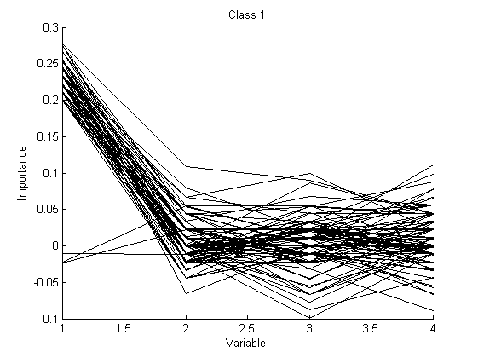
Variable Importance..
For Class-1
Variable-1 is important
Class-1 = 0-3 min delay
Variable-1 = train type
Conclusion:
Certain trains never get delayed
High priority trains
Rajdhani, Shatabdi etc.

Slide 18
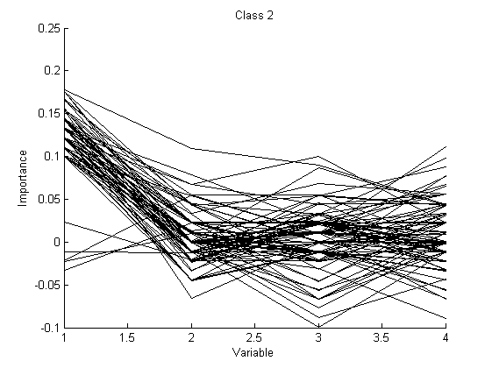
Variable Importance..
For Class-2
Variable-1 is important
Class-2 = 4-10 min delay
Variable-1 = train type
Conclusion:
Certain trains only slightly get delayed
High priority trains
Rajdhani, Shatabdi etc.

Slide 19
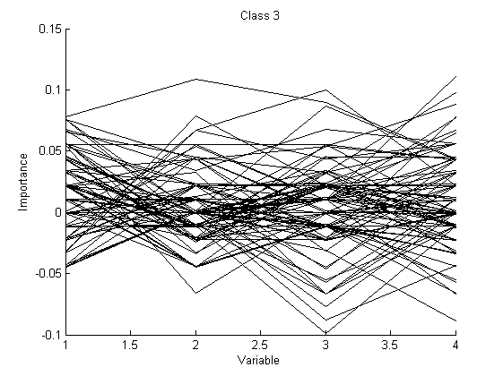
Variable Importance..
For Class-3
All variables have similar importance
Class-3 = 11-25 min delay
Nothing much can be concluded

Slide 20
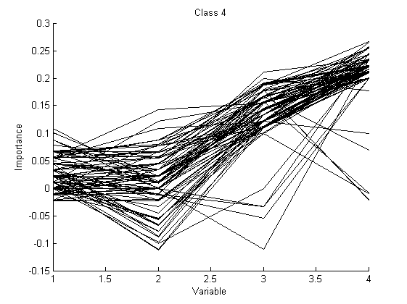
Variable Importance..
For Class-4
Variable-4 is important
Class-4 = 25-60 min delay
Variable-4 = Day of week
Conclusion:
Trains are delayed on specific days of week
Weekends
Region of run also important

Slide 21
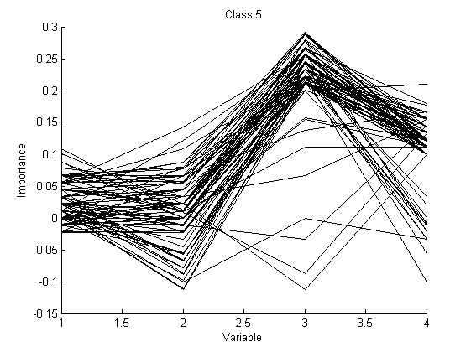
Variable Importance..
For Class-5
Variable-3 is important
Class-5 = > 60 min delay
Variable-3 = Region of run
Conclusion:
Trains running in certain regions are drastically late.
UP/Bihar zone

Slide 22
Analysis..
Variable Importance
Variable Interaction

Slide 23
Variable Interaction
Variables ‘m’ and ‘k’ interact if a split on one variable, say ‘m’, in a tree makes a split on ‘k’ either systematically less possible or more possible
Absolute difference of gini values averaged over the forest

Slide 24
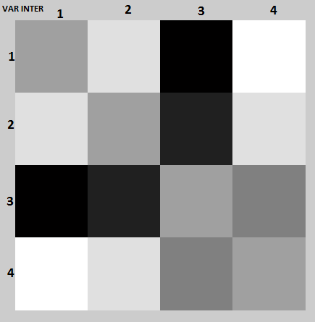
Variable Interaction..
Strong interaction between (var-1,var-3) and (var-2,var-3)

Slide 25
Variable Interaction..
(var-1,var-3) = (train type, region of run)
(var-2,var-3) = (distance, region of run)
Conclusion:
Trains of certain priority – no matter in which region they run it never get delayed (like Rajdhani).
Trains in certain regions always get delayed (UP/Bihar) irrespective of whether they are long or short distance trains.

Slide 26
Future Scope
X-Factor
Widening the scope of Regions/Stations
Using Railway Infrastructure
Let’s look at it from other side

Slide 27
QUESTIONS ?
THANK YOU

